Slide 1
December 2022
S.NO | Name of the student | Roll No. | Branch
1 | GURRAM ANKIT | 20951A0415 | ECE
2 | GOLLA BHUPAL | 20951A0430 | ECE

Slide 2
December 2022
PARKING INDICATOR
S.NO | Name of the student | Roll No. | Branch
1 | GURRAM ANKIT | 20951A0415 | ECE
2 | GOLLA BHUPAL | 20951A0430 | ECE

Slide 3
PROBLEM STATEMENT
Our aim is to make easy parking for the people in the shopping malls,apartments etc..
Our project is developed by using Arduino and some motion detecting sensors.
The sensors used in the project is motion detecting sensor which detects the motion of the vehicle and reduce the parking count.
This project is placed at the entry of the apartments, malls etc.
This will show them that the parking is available or not.. By this parking in malls can be made easily..

Slide 4
PROBLEM STATEMENT
Our aim is to make easy parking for the people in the shopping malls,apartments etc..
Our project is developed by using Arduino and some motion detecting sensors.
The sensors used in the project is motion detecting sensor which detects the motion of the vehicle and reduce the parking count.
This project is placed at the entry of the apartments, malls etc.
This will show them that the parking is available or not.. By this parking in malls can be made easily..

Slide 5
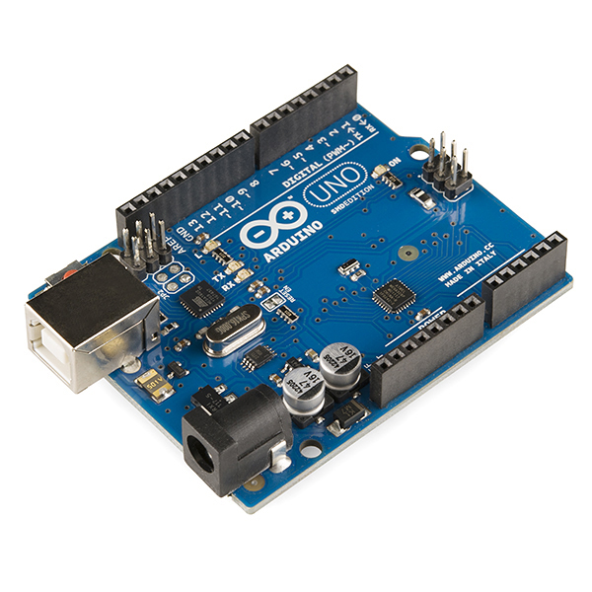
COMPONENTS USED
AURDUINO
IR PROXIMITY SENSOR
SERVO MOTOR
JUMMPERS
LED
BATTERY

Slide 6
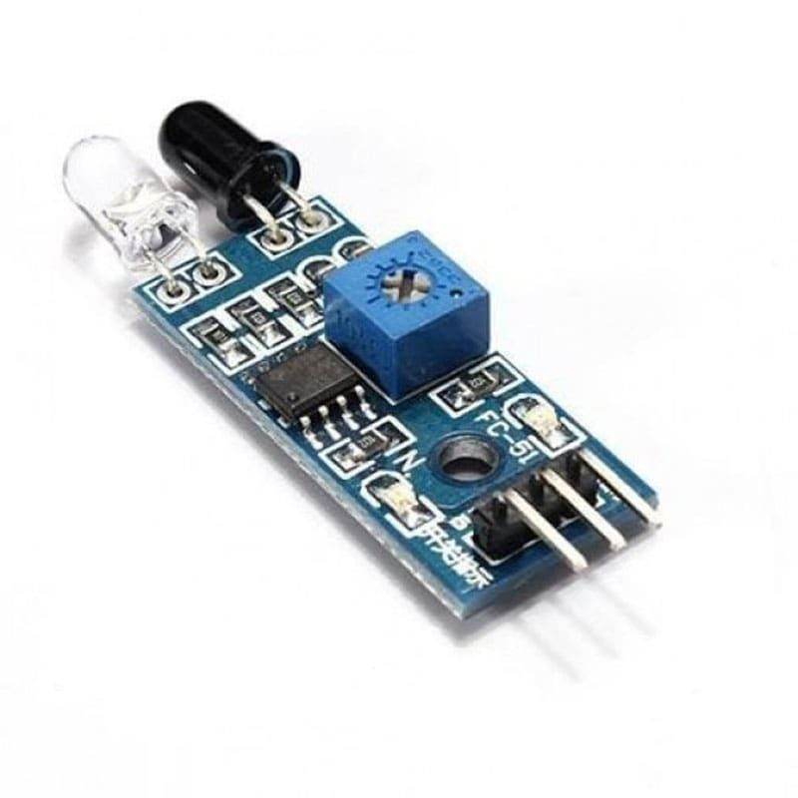
COMPONENTS USED
ARDUINO
IR PROXIMITY SENSOR
SERVO MOTOR
JUMMPERS
LED
BATTERY

Slide 7
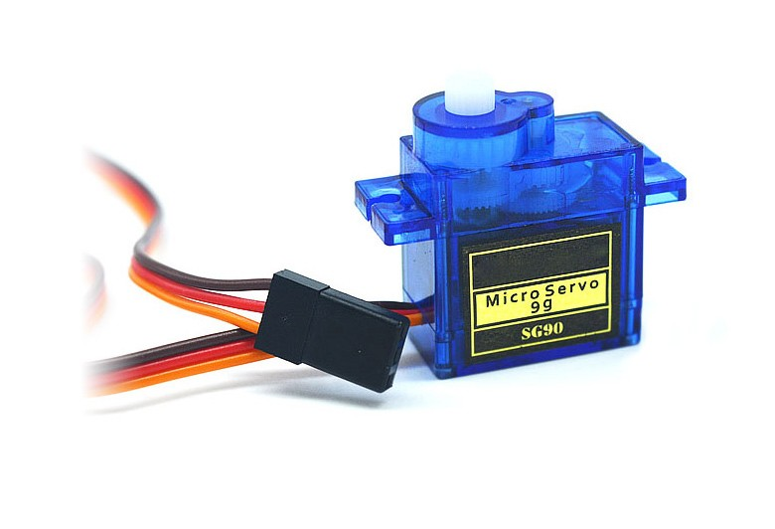
COMPONENTS USED
ARDUINO
IR PROXIMITY SENSOR
SERVO MOTOR
JUMMPERS
LED
BATTERY

Slide 8
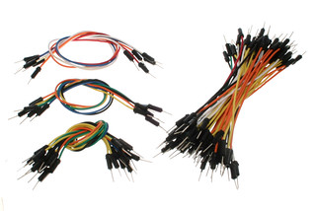
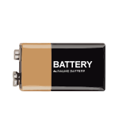
COMPONENTS USED
ARDUINO
IR PROXIMITY SENSOR
SERVO MOTOR
JUMMPERS
LED
BATTERY

Slide 9
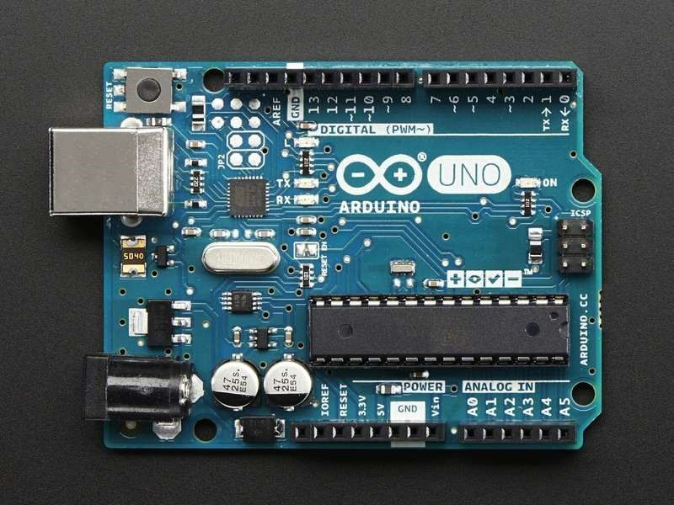
ARDUINO UNO
Arduino uno is an open-source platform used for building electronics projects.
Arduino consists of both a physical programmable circuit board and a piece of software, or IDE that runs on your computer, used to write and upload computer code to the physical board.
The code is written and stored in this a

Slide 10
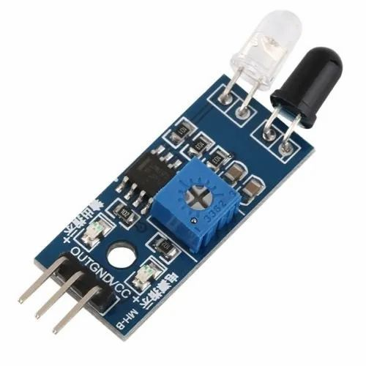
IR PROXIMITY SENSOR
This IR Proximity Sensor is a multipurpose infrared sensor which can be used for obstacle sensing, color detection, fire detection, line sensing, etc and also as an encoder sensor.
This sensor sense the obstacle and send a signal for servo motor to lift gate to enter the vehicle for parking if available.

Slide 11
SERVO MOTOR
Servo motors or “servos”, as they are known, are electronic devices and rotary or linear actuators that rotate and push parts of a machine with precision. Servos are mainly used on angular or linear position and for specific velocity, and acceleration.

Slide 12
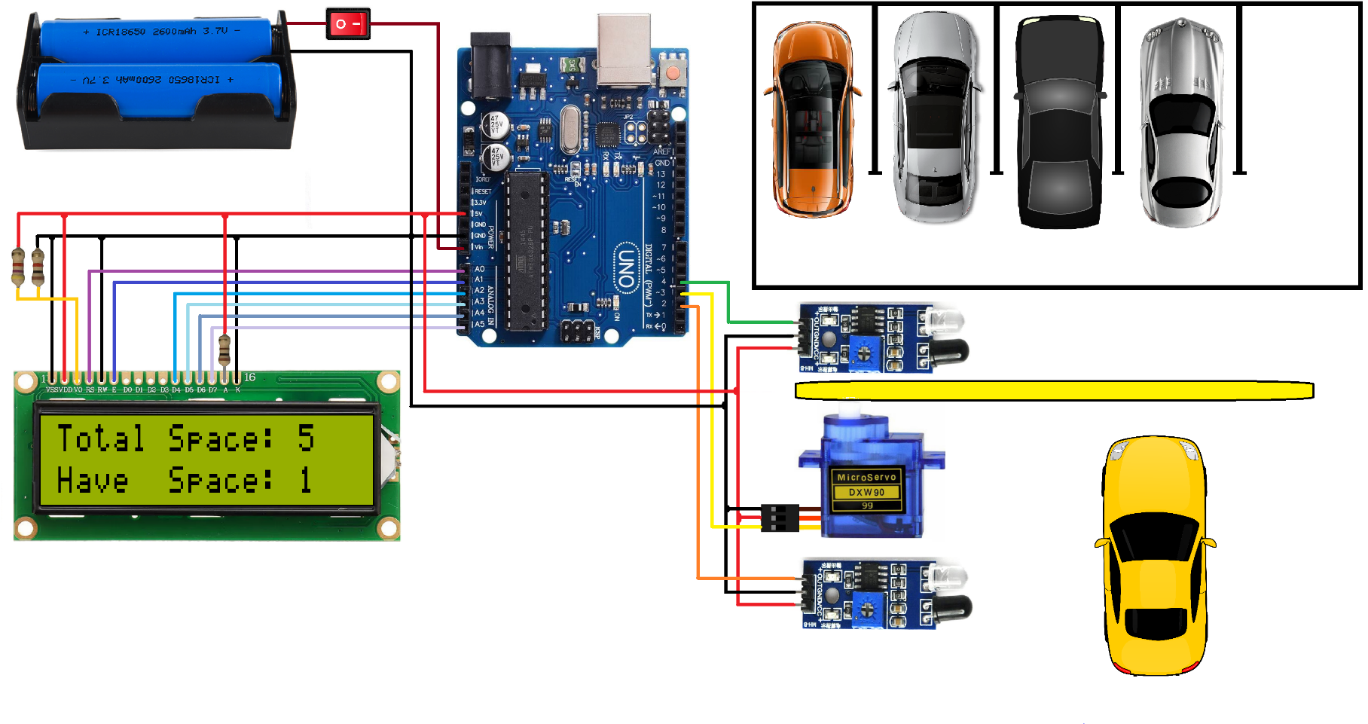
BLOCK DIAGRAM

Slide 13
ADVANTAGES
By this project the parking in the apartments will be made easy
Time saving process.
Easily we can know the availability of place for parking.

Slide 14
ADVANTAGES
By this project the parking in the apartments will be made easy
Time saving process.
Easily we can know the availability of place for parking.

Slide 15
THANK YOU

